Slide 1
Lending Club Case Study
GROUP MEMBERS:
ISHITA BHARGAVA
JATIN SINGH

Slide 2
Business Objective
Lending Club is Consumer Finance Company which provide loans to different segment of urban society according to their needs and wants.
When company receive the loan application, it goes through screening to check if loan can be given to customer or not based on applicant’s profile.
Two types of risk are associated with it to make decision:
If the applicant is likely to repay the loan, then not approving the loan results in a loss of business to the company.
If the applicant is not likely to repay the loan, i.e. he/she is likely to default, then approving the loan may lead to a financial loss for the company.
Company wants to understand the driving factors to understand who customer can be defaulter, who can be loyal customer.

Slide 3
Exploratory Data Analysis
Data Understanding
Outlier Detection
Univariate Analysis
Bivariate Analysis
Multi-Variate Analysis
Insights
Data Cleaning

Slide 4
Data Cleaning
We have Removed 57 Columns as they have more 90% missing values.
We have Dropped ‘Desc’, ‘Title’ column because title is a subcategory of ‘purpose’ and ‘Desc’ is the description of ‘Title’ in detail. We decided to keep ‘Purpose’ for our analysis and drop ‘Desc’ and ‘Title’.
We also removed columns which contains only single values or more than 80% row values are same.
Imputing missing values according to column category i.e. Either Categorical or Numerical.
Standardizing quantitative values in the dataset and correcting the datatypes for date related columns.
Extracted Year columns as derived metrics to understand the dataset.

Slide 5
Data Understanding
Categorical
term
grade
sub_grade
emp_length
home_ownership
verification_status
issue_d
loan_status
purpose
zip_code
addr_state
earliest_cr_line
inq_last_6mths
last_pymnt_d
last_credit_pull_d
Numerical
Loan_amnt
funded_amnt
int_rate
installment
annual_inc
dti
revol_bal
revol_util
total_acc
total_pymnt
total_rec_prncp
total_rec_int
total_rec_late_fee
last_pymnt_amnt
Others
id
member_id
open_acc

Slide 6
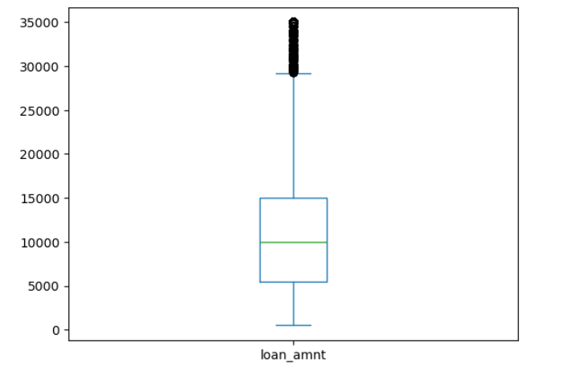
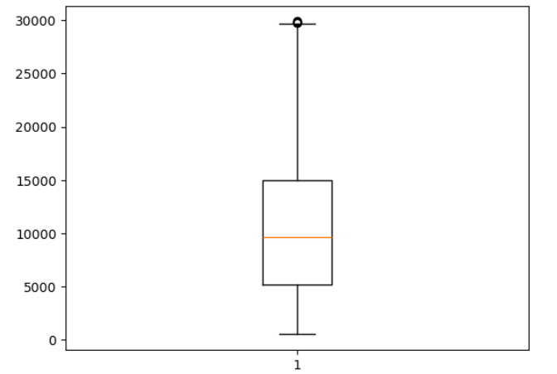
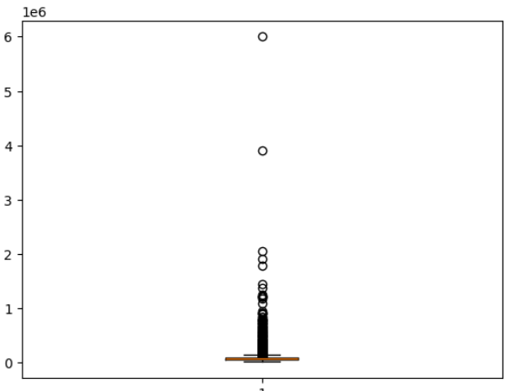
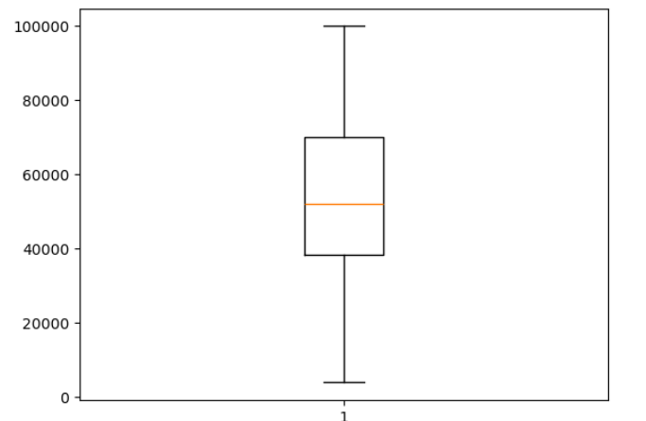
Outlier Detection
Checking Outliers in ‘loan amount’ using boxplot and taking loan amount upto 30000 only.
Removing Outlier from ‘annual_inc’ columns and keeping only till 100,000.
Using Box plot and countplot we have removed outliers from other major column as well like ‘funded_amnt’, ‘int_rate’ etc.
Removing unnecessary columns also helped to remove outliers from dataset.

Slide 7
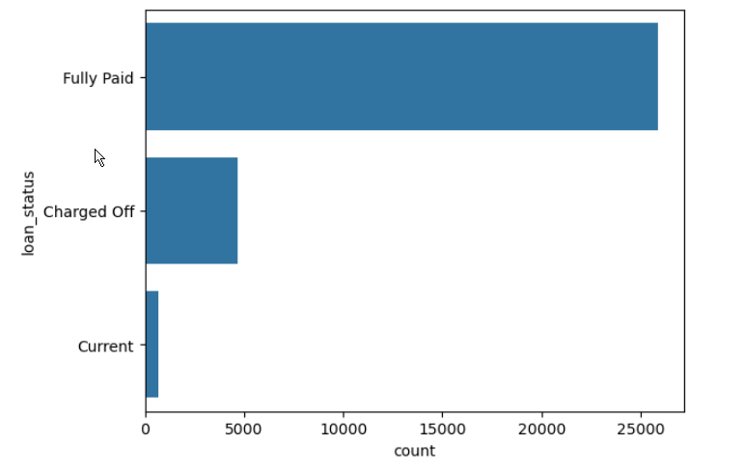
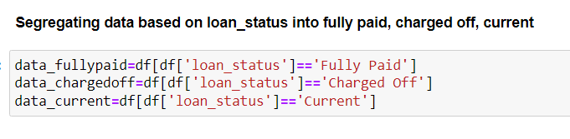
Univariate Analysis
Using countplot on ‘loan_status’ shows that majorly customers are divided into 3 subcategories in dataset. Using ‘loan_status’ as anchor columns we have further drill downed our analysis for other columns.

Slide 8
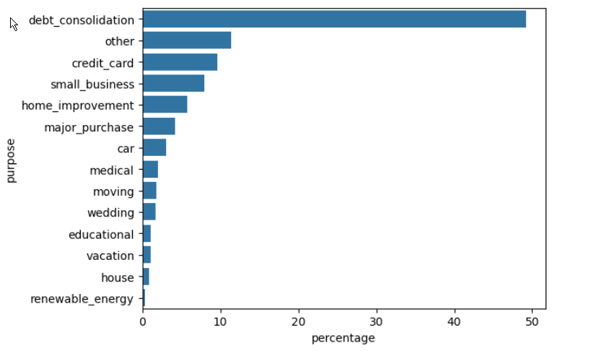
Contd…
Approximately 48% customer who have taken loan for debt consolidation are mostly defaulted.
‘Purpose’ of Charged-off borrowers

Slide 9
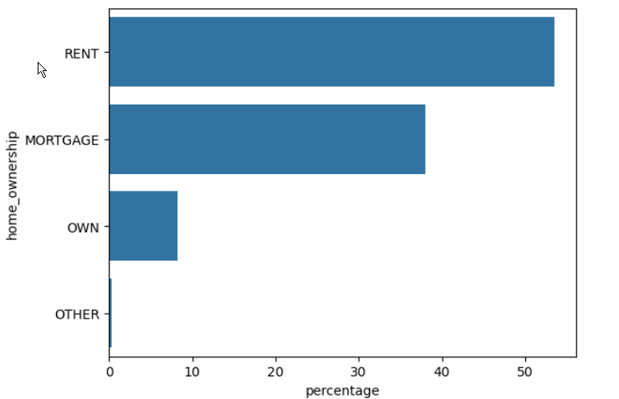
Contd…
‘Home_onwership’ of Charged-off borrowers
Customers living on rent are more likely to default than the customer having mortgage or own their own house.

Slide 10
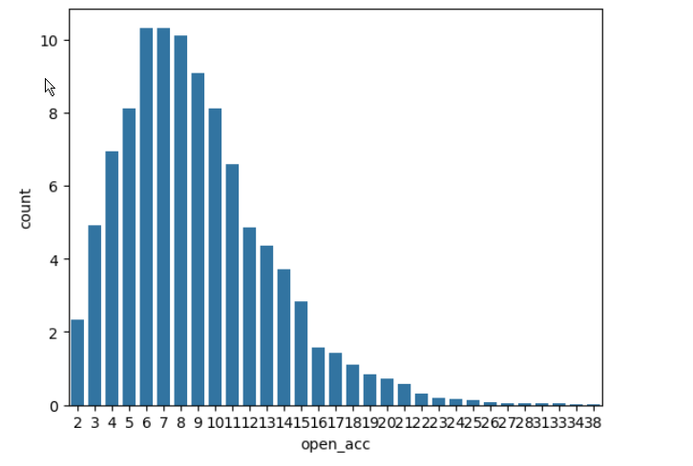
Contd…
‘Open_acc’ on charged-off borrower
We had made an assumption that Defaulters will mostly have more open loans but Data is rightly skewed which shows that defaulter have open loans in range of 5-10.

Slide 11
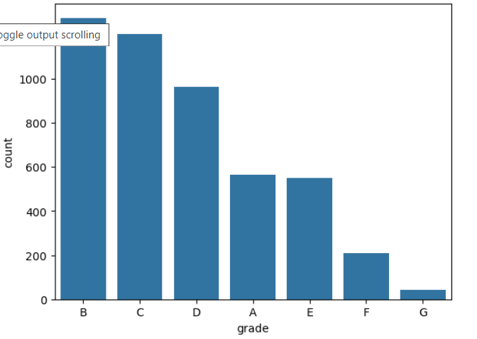
Contd…
‘Grade’ count on Charged-off borrowers
Customer who have been given a grade of B, C, D by LC are most likely to default.

Slide 12
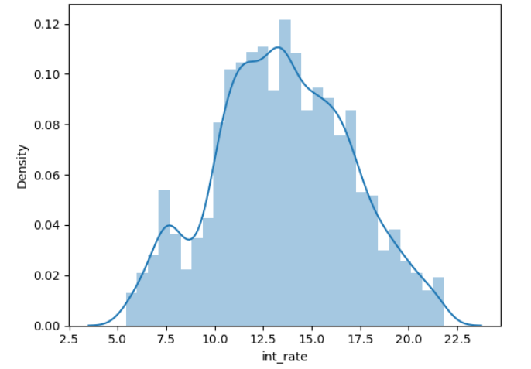
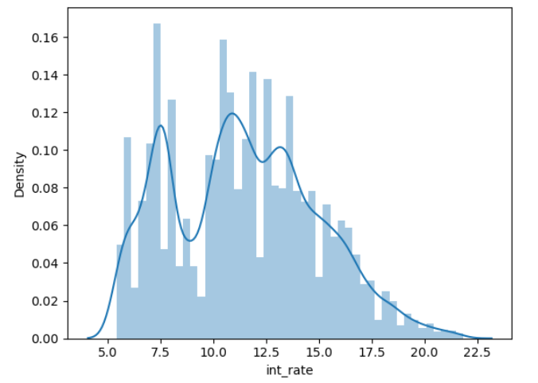
Contd…
Interest rate for defaulted borrower is ranges around 12%-16%
Interest rate for non-defaulters ranges around 6%-8% and 12.5%-15%. This means borrowers are defaulting more who have high interest rate generally.
Interest rate on
Fully paid borrowers
Interest Rate on Charged-off borrowers

Slide 13
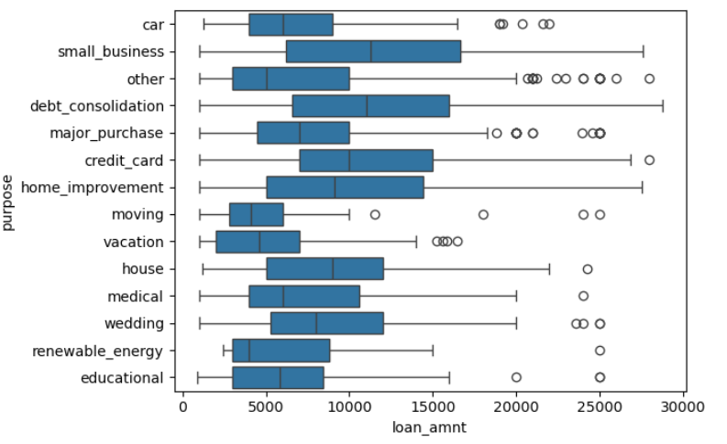
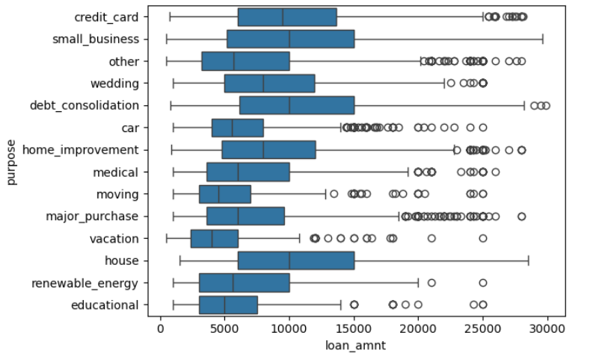
Bivariate Analysis
Analysis shows IQR range of Small business is more in defaulters as compare to closed loans.
Vacation IQR range is less in fully-paid borrowers, it means borrowers are taking less loans for vacation hence they are not defaulting.
‘Purpose’ vs ‘loan_amnt’
On charged-off borrowers
‘Purpose’ vs ‘loan_amnt’
On fully-paid borrowers

Slide 14
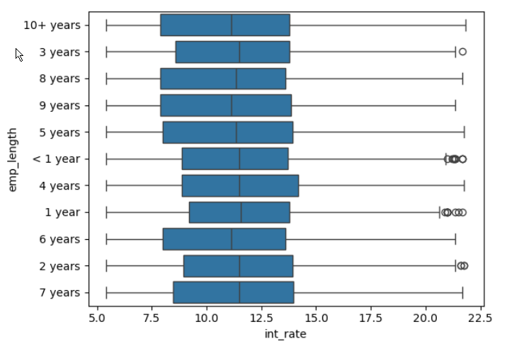
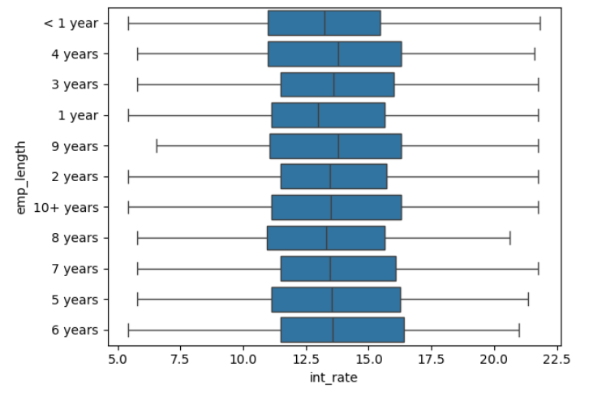
Contd…
All defaulted customers are paying more interest rate as compare to non-defaulter customers.
‘Int_rate’ vs ‘emp_length’
For Charged-off borrowers
‘Int_rate’ vs ‘emp_length’
For fully-paid borrowers

Slide 15
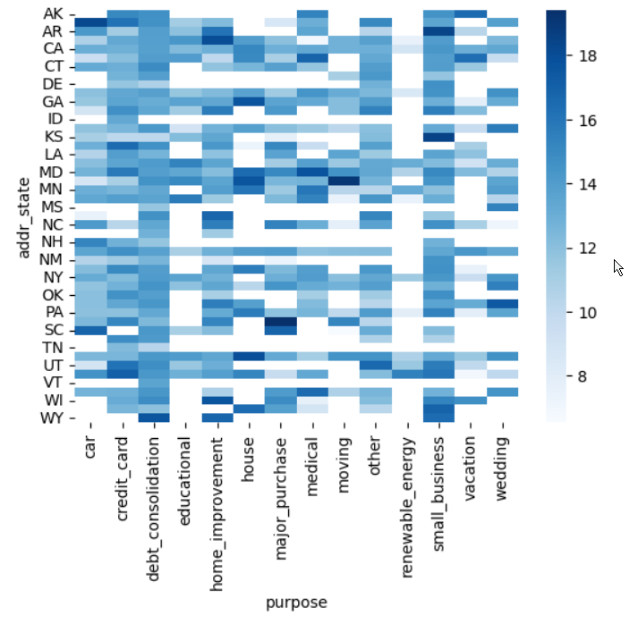
Multivariate Analysis
‘Int_rate’ & ‘addr_state’ & ‘purpose’
On Charged-off borrower
Renewable Energies have very less defaulters.
Debt_consolidation borrowers are generally getting defaulted.
CA States have more defaulters as compare to other states

Slide 16
Recommendation
Lending Club should consider avoiding loans sanctions to customer how are consolidating loans as they are more prone to getting defaulted.
Borrowers are taking loans for 60 months are 20% more getting defaulted, so less tenure loans are better in most cases.
Having more interest rate for some purpose like Small business attract more defaulters, lending club should consider reducing interest rate for these type of cases.
Defaulted Customer having less annual income taking bigger loans, LC should have upper cap for sanctioning loans based on income.

